Slide 1
CS 186 Discussion #3
Joins

Slide 2
Logistics
HW2 coming soon, due 9/28
Query Planning and Joins
Partners Optional
Sharing one Github repo

Slide 3
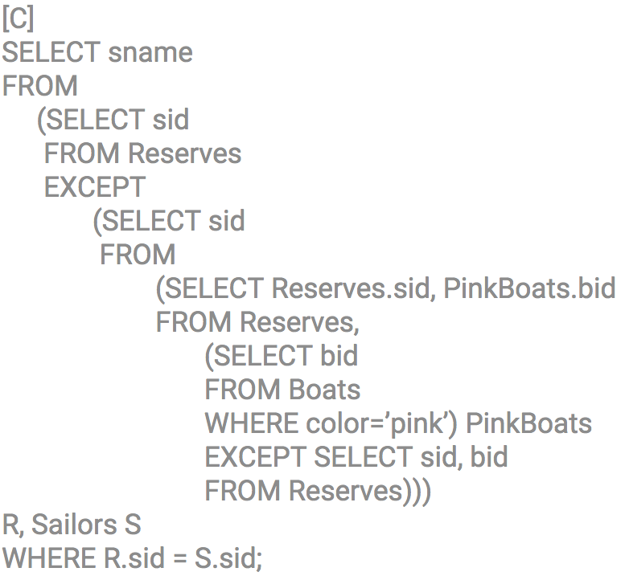
Revisiting SQL…

Slide 4
Joins

Slide 5
Left Outer Join
TABLE Students
TABLE Enrollment
SID | Name
23357852 | Bob the Builder
24821529 | Anonymous
27983421 | Nicholas
27994495 | Oskicat
CCN | SID
25227 | 23357852
26586 | 23357852
21545 | 21592421
23495 | 23374219
26586 | 27994495
SID | Name | CCN | SID
23357852 | Bob the Builder | 25227 | 23357852
23357852 | Bob the Builder | 26586 | 23357852
24821529 | Anonymous
27983421 | Nicholas
27994495 | Oskicat | 26586 | 27994495

Slide 6
Cost Notation
[R] = number of pages in Table R
p_{R} = number of records per page of R
|R| = number of records in R
(cardinality)
Note: |R| = p_{R}*[R]

Slide 7
Simple Nested Loop Join
First iteration of outer loop…
Compare with all tuples in S
…and add matches to result
R
S

Slide 8
Simple Nested Loop Join
Second iteration of outer loop…
Compare with all tuples in S
…and add matches to result
R
S

Slide 9
Simple Nested Loop Join
Cost =
[R] + p_{R}[R][S]
R
S

Slide 10
Page-Oriented Nested Loop Join
First iteration of outer loop…
Compare with all tuples in S
…and add matches to result
R
S

Slide 11
Page-Oriented Nested Loop Join
Second iteration of outer loop…
Compare with all tuples in S
…and add matches to result
R
S

Slide 12
Page-Oriented Nested Loop Join
Cost =
[R] + [R][S]
R
S

Slide 13
Chunk Nested Loop Join
First iteration of outer loop…
B pages in memory!
Use B – 2 for R
Compare with all tuples in S
…and add matches to result
R
S

Slide 14
Cost of CNLJ?
[R] + (# chunks in R) * [S]
=[R] + (^{[R]} /_{chunksize}) * [S]
=[R] + ^{[R][S]}/_{(B – 2)}

Slide 15
Sort-Merge Join
Sort R and S using external sorting:
4[R] + 4[S] (2 passes)
Scan sorted R and sorted S “in tandem” and output matches:
[R] + [S]
Does this include final write costs?
Notes:
Worst case for Step 2 is [R] * [S]
What if you have duplicates that are joined from [R]?

Slide 16
Optimized Sort-Merge Join
Sort R and S using external sorting, but stop before the final pass:
2[R] + 2[S]
Join on the final merge pass!
[R] + [S] + [output]
Is [R] + [S] an upper bound on join cost?

Slide 17
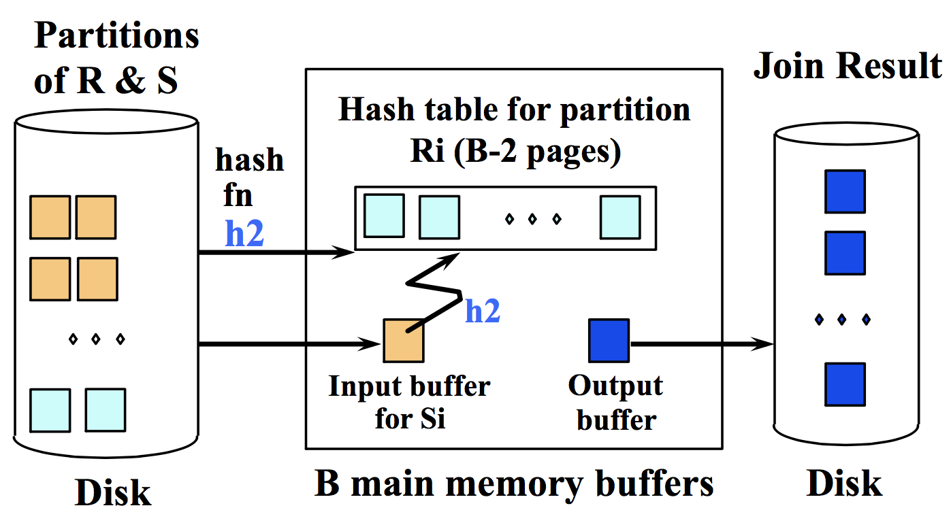
Hash Join
Partition both tables! => 2[R] + 2[S]
Build a hash table for R
Then match (“probe”) => [R] + [S]:
Even better with hybrid hashing!

Slide 18
Join Costs Overview
Chunk Nested Loop Join
[R] + ^{[R][S]}/_{(B – 2)}
Sort-Merge Join / Hash Join
3[R] + 3[S]

Slide 19
Sort-Merge vs. Hash Join
Chunk Nested Loop Join
Works for cross (Cartesian) products
Works for non-equality predicates
Scales nicely with buffer size!
Sort-Merge Join
Hash Join
Good with sorted input/output
Handles data skew + bad hashing (large partitions)
Good with limited memory
Good with hashed input/output
# passes bounded by smaller relation! Why?
Hybrid hashing

